Slide 1
File Management

Slide 2
File Management
File is a named, ordered collection of information
File management describes the fundamental methods for naming, storing and handling files
The file manager administers the collection by:
Storing the information on a device
Mapping the block storage to a logical view
Allocating/deallocating storage
Providing file directories

Slide 3
Why Programmers Need Files
<head>
…
</head>
<body>
…
</body>
HTML
Editor
Web
Browser
File
Manager
foo.html
File
Manager
<head>
…
</head>
<body>
…
</body>
Structured information
Can be read by any appln
Accessibility
Protocol
Persistent storage
Shared device

Slide 4
Think of a disk as a linear sequence of fixed-size blocks and supporting reading and writing of blocks.
The file system must keep track of which blocks belong to which files.
which blocks belong to which files.
In what order the blocks form the file.
which blocks are free for allocation.

Slide 5
Disk Organization
Boot Sector
Volume Directory
Blk₀
Blk₁
…
Blk_{k-1}
Track 0, Cylinder 0
…
Blk_{k}
Blk_{k+1}
Blk_{2k-1}
Track 0, Cylinder 1
…
Blk
Blk
…
Blk
Track 1, Cylinder 0
…
Blk
Blk
…
Blk
Track N-1, Cylinder 0
…
Blk
Blk
…
Blk
Track N-1, Cylinder M-1

Slide 6
Low-level File System Architecture
Block 0
b₀ b₁ b₂ b₃
…
…
b_{n-1}
.
.
.
Sequential Device
Randomly Accessed Device

Slide 7
A file system is the methods and data structures that an operating system uses to keep track of files on a disk or partition
It is an organization of data and metadata on a storage device
A simple description of the UNIX system, also applicable to Linux, is this:
"On a UNIX system, everything is a file; if something is not a file, it is a process.“

Slide 8
A Possible File System Layout
Superblock contains info about the fs (number of blocks in the partition, size of the blocks, free block count and free-block pointers etc)
i-nodes contain info about files
Tanenbaum, Modern Operating Systems 3 e, (c) 2008 Prentice-Hall, Inc. All rights reserved. 0-13-6006639

Slide 9
File System
A file system is consists of a sequence of logical blocks (512/1024 byte etc.)
A file system has the following structure:
Boot Block | Super Block | Inode List | Data Blocks

Slide 10
Filesystem performance
Two predominant performance criteria:
Speed of access to file’s contents
Efficiency of disk storage utilization
How can these be meaningfully measured

Slide 11
Free space management
Need for free space management
Limited amount of disk space
Necessary to use disk space from deleted file space
System maintains a free space list which will record all disk blocks that are free

Slide 12
Since disk space is limited, we need to reuse the space from deleted files for new files, if possible.
To keep track of free disk space, the system maintains a free-space list. The free-space list records all free disk blocks.
To create a file, we search the free-space list for the required amount of space and allocate that space to the new file.
When a file is deleted, its disk space is added to the free-space list.

Slide 13
Free space list implementation techniques
Bit Vector
Linked List
Grouping
Counting

Slide 14
Bit vector
Free-space list is implemented as a bit map or bit vector.
Each block is represented by 1 bit. If the block is free, the bit is 1; If the block is allocated, the bit is O.
For example, consider a disk where blocks 2, 3, 4, 5, 8, 9, 10, 11, 12, 13, 17, 18,25,26, and 27 are free and the rest of the blocks are allocated.
001111001111110001100000011100000 ...

Slide 15
Unfortunately, bit vectors are inefficient unless the entire vector should be kept in main memory (and is written to disk occasionally for recovery needs).
It is only possible to keep it in main for smaller disks but not necessarily for larger ones.
A 1.3 GB disk with a 512 bytes block and a 32-bit (4 bytes) disk block number, we need a bit map of over 332KB to track its free blocks
Relatively simple and efficient. Easy to get contiguous space.

Slide 16
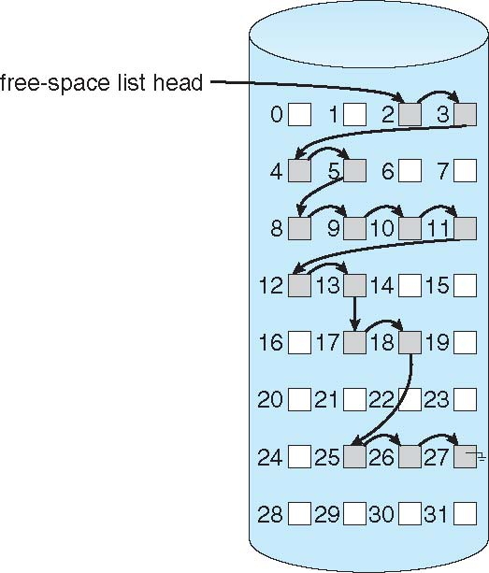
Linked list
Linked free space list on disk
Link together all the free disk blocks, keeping a pointer to the first free block in a special location on the disk and caching it in memory.
This first block contains a pointer to the next free disk block, and so on.

Slide 17
Linked list
No Wastage of space
Cannot get contiguous space
Not efficient for faster access

Slide 18
Grouping
In this we store the addresses of n free blocks in the first free block.
The first of n-1 these blocks are actually free. The last block contains the addresses of another n free blocks, and so on.
The addresses of a large number of free blocks can now be found quickly, unlike the situation when the standard linked-list approach is used.

Slide 19
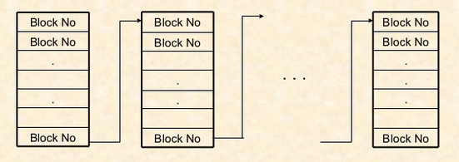
Grouping

Slide 20
Counting
Based on fact that several contiguous blocks may be allocated or freed simultaneously
keep the address of the first free block and the number of “n” free contiguous blocks that follow the first block.
Each entry in the free-space list then consists of a disk address and a count.

Slide 21
Counting
Advantages
Each entry in the list requires more space than a simple disk address
The overall list will be shorter, as the count is greater than 1.

Slide 22
File Allocation Methods Contiguous Allocation
Each file occupies a set of contiguous blocks on the disk.
Number of blocks needed are identified at file creation
May be increased using file extensions
Advantages:
Simple to implement
Good for random access of data
Disadvantages
Files cannot grow
Wastes space

Slide 23
Contiguous Allocation
FileA
File Allocation Table
FileA
0
1
2
3
4
File Name
Start Block
Length
5
6
7
8
9
FileA
2
3
FileB
FileB
9
5
10
11
12
13
14
FileC
18
8
FileD
30
2
15
16
17
18
19
FileE
26
3
FileC
20
21
22
23
24
FileE
25
26
27
28
29
FileD
30
31
32
33
34

Slide 24
File Allocation Methods Linked Allocation
Each file consists of a linked list of disk blocks.
Advantages:
Simple to use (only need a starting address)
Good use of free space
Disadvantages:
Random Access is difficult
data
ptr
data
ptr
data
ptr
data
Null

Slide 25
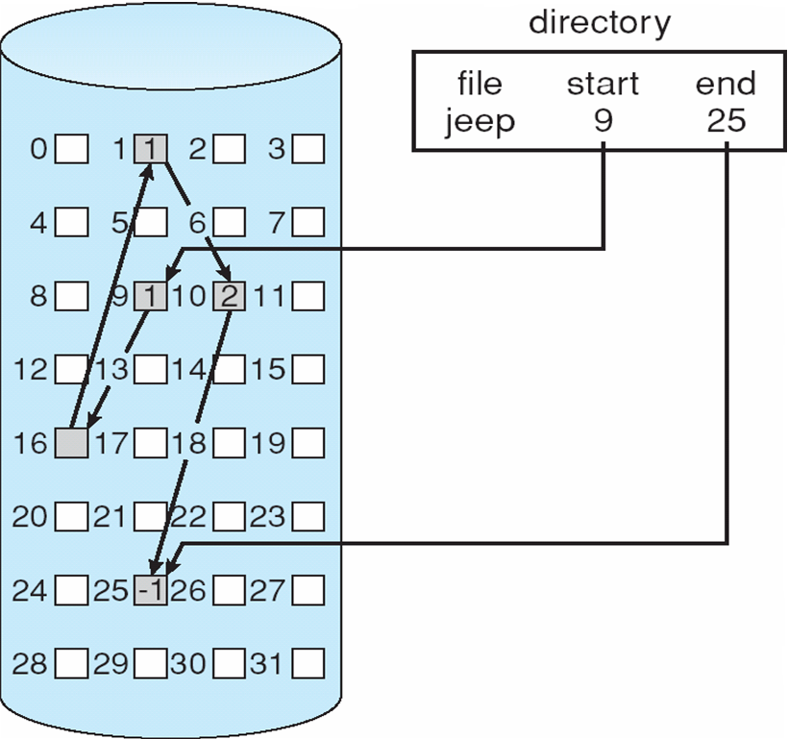
Linked allocation

Slide 26
Allocation Methods Indexed Allocation
Collect all block pointers into an index block.
Advantages:
Random Access is easy
No external fragmentation
Disadvantages
Overhead of index block
Index Table

Slide 27
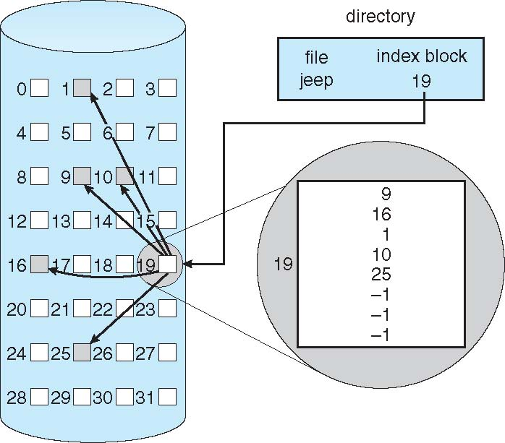
Indexed allocation

Slide 28
UNIX i-node
mode
owners(2)
timestamps(3)
data
size block
count
data
direct blocks
data
single indir
double indir
triple indir

Slide 29
Directory Structure
Collection of nodes containing information on all files
F4
F2
F3
F5
F1

Slide 30
Information in a Device Directory
File name:
File Type:
Address:
Current Length
Maximum Length
Date Last accessed (for archiving)
Date Last updated (for dumping)
Owner ID
Protection information

Slide 31
Directory Operations
Search for a file
Create a file
Delete a file
List a directory
Rename a file
Traverse the file system

Slide 32
Alternative Directory Structures
Single-Level Directory
Issues:
Naming
Grouping
cat bo a test data mail cont hex word calc

Slide 33
Alternative Directory Structures
Two-Level Directory
User1 User2 User3

Slide 34
Tree-Structured Directory

Slide 35
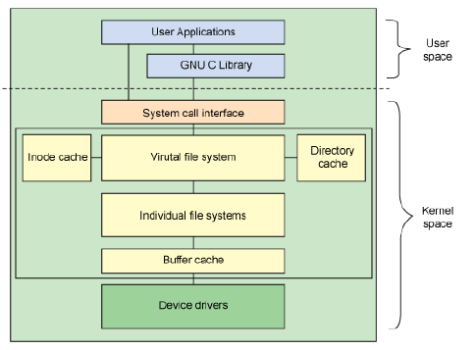
Architectural view of Linux file system components

Slide 36
The VFS is the primary interface to the underlying file systems.
This component exports a set of interfaces and then abstracts them to the individual file systems, which may behave very differently from one another

Slide 37
Linux file system : Cross-development
Linux: first developed on a minix system
Both OSs shared space on the same disk
So Linux reimplemented minix file system
Two severe limitations in the minix FS
Block addresses are 16-bits (64MB limit)
Directories use fixed-size entries (w/filename)

Slide 38
Extended File System
Originally written by Chris Provenzano
Extensively rewritten by Linux Torvalds
Initially released in 1992
Removed the two big limitations in minix
Used 32-bit file-pointers (filesizes to 2GB)
Allowed long filenames (up to 255 chars)
Question: How to integrate ext into Linux?

Slide 39
Xia and Ext2 filesystems
Two new filesystems introduced in 1993
Both tried to overcome Ext’s limitations
Xia was based on existing minix code
Ext2 was based on Torvalds’ Ext code
Xia was initially more stable (smaller)
But flaws in Ext2 were eventually fixed
Ext2 soon became a ‘de facto’ standard

Slide 40
VFS
What is it ?
VFS is a kernel software layer that handles all system calls related to file systems. Its main strength is providing a common interface to several kinds of file systems.

Slide 41
The Virtual File System idea
Multiple file systems need to coexist
But file systems share a core of common concepts and high-level operations
So can create a file system abstraction ?
Applications interact with this VFS
Kernel translates abstract-to-actual

Slide 42
Task 1
Task 2
…
Task n
user space
kernel space
VIRTUAL FILE SYSTEM
minix
ext2
msdos
proc
Buffer Cache
device driver
for hard disk
device driver
for floppy disk
Linux Kernel
software
hardware
Hard Disk
Floppy Disk

Slide 43
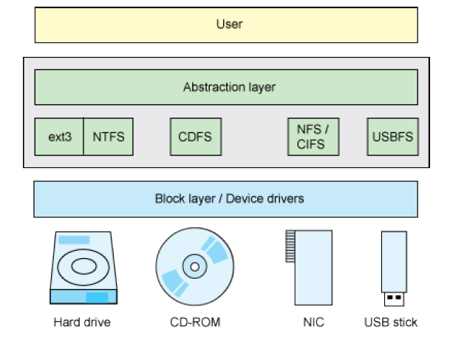
VFS provides a uniform interface

Slide 44
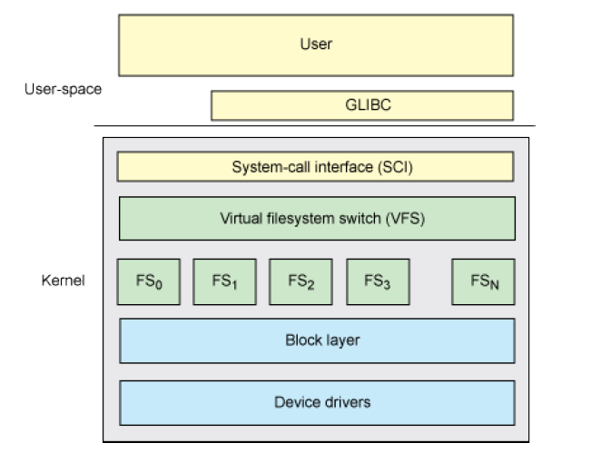
Layered archi of vfs

